Slide 1




High-Quality Code: Course Introduction
Course Program, Evaluation, Exams, Resources

Slide 2

Table of Contents
Next step in Telerik Software Academy
The High-Quality Code Course Program
The Trainers Team
Teamwork Project
Exams and Evaluation
The Practical Exam
Recommended Books
Resources for the Course

Slide 3

High-Quality Code
The Next Module in the Software Academy (Programming Track)

Slide 4

Next Step in Telerik Software
High-Quality Code
Continuation of OOP course
Quality coding, unit testing, refactoring, software engineering, design patterns
Lectures once a week
The course exam?
Team work project
Practical exam

Slide 5



High-Quality Code Course Program
What Will Be Cover in the Course?

Slide 6
The Course Program
Course Overview. Introduction to High-Quality Programming Code. Code Formatting
Correctly Naming Identifiers in the Code (Classes, Properties, Methods, Parameters, Variables, etc.) Code Documentation and Comments
Using Variables, Data, Expressions and Constants. Using Control Structures, Conditional Statements and Loops
High-Quality Methods. Cohesion and Coupling. High-Quality Classes and Class Hierarchies

Slide 7
The Course Program (2)
Defensive Programming and Exceptions. Performance Tuning and Code Optimization
Unit Testing. Mocking. Test-Driven Development
Code Refactoring. Refactoring Patterns. Effective Debugging: Tools and Techniques
Development Tools. IDEs. Change Management Systems. Code Analysis Tools. Automated Testing Tools. Automated Build Tools. Continuous Integration Tools. Team Collaboration Tools
Design Patterns: the Classical GoF Patterns

Slide 8

The Course Program (3)
Fundamentals of Software Engineering (Idea, Architecture, Design, Implementation, Testing, Deployment, Support). Development Methodologies. Scrum. Project Management
Exam Preparation
Teamwork Projects
Teamwork Public Defense
Practical Exam

Slide 9

The Trainers Team

Slide 10
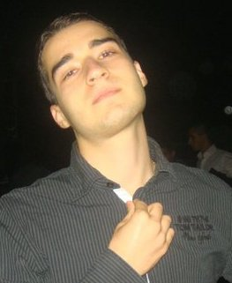
Trainers Team
Nikolay Kostov
Team Lead, Senior Developer and Trainer @ Telerik Corp.
Student at Sofia University
Computer Science
IT and Informatics competitions contestant
Graduate from the second season of Telerik Software Academy
Email: nikolay.kostov [at] telerik.com
Blog: http://nikolay.it

Slide 11
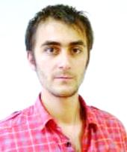
Trainers Team (2)
Doncho Minkov
Senior Technical Trainer @ Telerik Software Academy
Student in Sofia University
Software Engineering
Contestant in the Informatics competitions
Graduate from the first season of Telerik Software Academy
Email: doncho.minkov [at] telerik.com
Blog: http://minkov.it

Slide 12
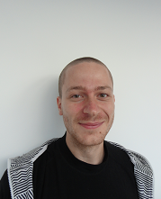
Trainers Team (3)
Ivaylo Kenov
Junior Technical Trainer @ Telerik Software Academy
Graduate from the fourth season of Telerik Software Academy
Mathematical competitions contestant
E-mail: ivaylo.kenov [at] telerik.com
Champion in OOP and DSA

Slide 13




Evaluation
Code
Thank God There Are Bonuses!
Quality

Slide 14

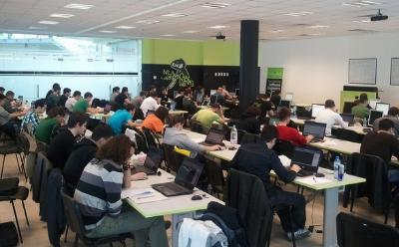
High-Quality Code – Evaluation
Evaluation components
Practical exam – 60%
Team work – 15%
Homework – 10%
Homework evaluation – 5%
Attendance in class – 10%
Bonuses
Forums activity – bonus up to 5%

Slide 15


Pass / Excellence / Fail Criteria
Criteria for pass / pass with excellence / fail
Pass with excellence
Very high exam results
or
High total results
Pass
Average total results
Fail
Low total results or 0 at the exam

Slide 16
Homework Peer Reviews
Everyone will get feedback for their homework
Everyone will give feedback for few random homework submissions
Students submit homework anonymously
Please exclude your name from the submissions!
For each homework submitted
Students evaluate 3 random homeworks
From the same topic, after the deadline
Give written feedback, at least 200 characters
Low-quality feedback → report for punishment

Slide 17
Teamwork Project
Teamwork project requirements
Teams of 3-5 students (balanced random)
Given a low-quality C# project
Refactor the code
Improve its quality and make it testable
Write unit tests (with high coverage) + docs
Use source control system
Each team member should have commits during the whole assignment
Public project defense

Slide 18

Practical Exam
You will be given a C# interface
You need to implement it (write the code)
According to the documentation
Write unit tests
High code coverage
Catch all possible defects
Assessment
Unit tests will be automatically checked
Additional manual check

Slide 19



Use the Same Email!
Please use the same email address in:
http://telerikacademy.com
http://bgcoder.com
http://forums.academy.telerik.com
Otherwise your score could be incorrectly calculated!

Slide 20

Recommended Books

Slide 21

The C# Textbook
The official textbook for the course
“Introduction to Programming with C#”, Nakov S. and his team, 2010
Freely downloadable from: www.introprogramming.info
The C# programming tracks follows the book
High-quality code → chapter 21

Slide 22
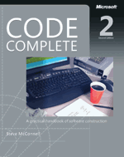


Recommended Books
Code Complete, 2nd Edition, Steve McConnell, ISBN 0735619670, http://www.cc2e.com
Refactoring: Improving the Design of Existing Code, Martin Fowler, Kent Beck, John Brant, William Opdyke, Don Roberts, ISBN 0201485672, http://martinfowler.com/
Test Driven Development: By Example, Kent Beck, ISBN 0321146530

Slide 23








Resources
What We Need in Addition to this Course Content?

Slide 24

Course Web Site & Forums
Register for the "Telerik Academy Forums":
Discuss the course exercises with your colleagues
Find solutions for the exercises
Share source code / discuss ideas
The High-Quality Code official web site:
forums.academy.telerik.com/high-quality-code
http://academy.telerik.com/student-courses/programming/high-quality-code/

Slide 25
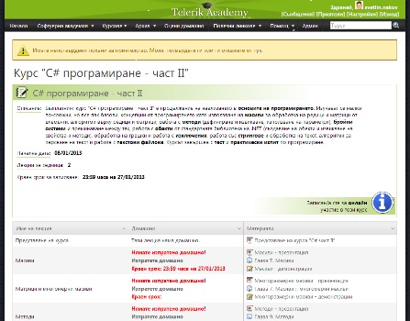
Telerik Integrated Learning System (TILS)
The Telerik Integrated Learning System (TILS)
www.telerikacademy.com
Important resource for all students
Homework submissions
Homework peer reviews
Presence cards with barcode
Reports about your results
telerikacademy.com/Courses/Courses/Details/174

Slide 26


Required Software
Software needed for this course:
Microsoft Windows (XP / Win7 / Win8)
Microsoft Visual Studio 2012/2013 or Visual Studio Express 2012/2013 (free version of VS)
.NET Framework 4.5 (included in Visual Studio)
Visual Studio 2005, 2008 or 2010 is also OK

Slide 27

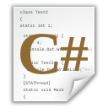



High-Quality Code: Course Introduction
http://academy.telerik.com

Slide 28




Free Trainings @ Telerik Academy
C# Programming @ Telerik Academy
csharpfundamentals.telerik.com
Telerik Software Academy
academy.telerik.com
Telerik Academy @ Facebook
facebook.com/TelerikAcademy
Telerik Software Academy Forums
forums.academy.telerik.com

